Slide 1

Artificial Intelligence
Alzheimer’s Classification
20 April, 2026
Humaira Habib Usha (2023-1-60-022)
Shawna Akter (2023-1-60-071)
Bushra Khan Zhilik (2023-1-60-087)
Sheikh Hossain Bin Bakhtiar (2023-1-60-060)

Slide 2
01
Introduction
06
Results and Conclusion
02
EDA Analysis
07
Thank You
Overview
03
Pretrained Models
04
Custom CNN
05
CBAM CNN

Slide 3
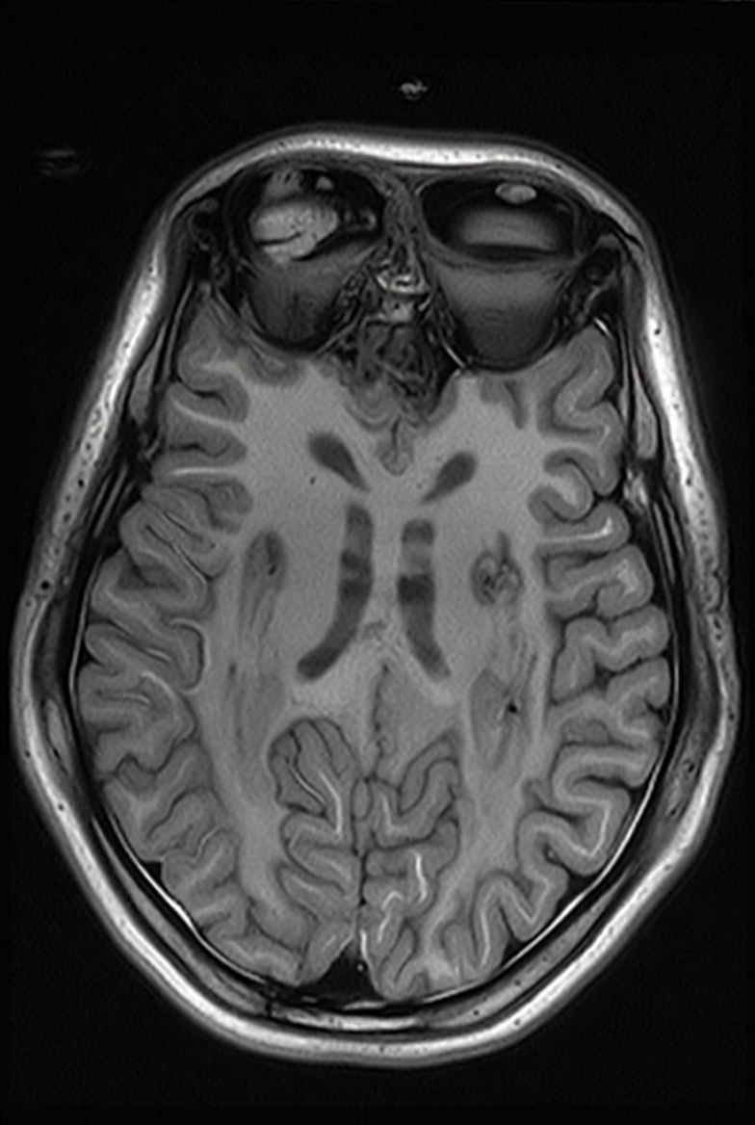
Introduction
What is Alzheimer and how to indentify it?
Alzheimer’s disease (AD) is a progressive neurodegenerative disorder that gradually destroys memory, cognitive abilities, and the capacity to perform daily tasks. It is the most common cause of dementia worldwide. The patterns are:
Hippocampal atrophy (shrinkage of the memory centre)
Cortical thinning (especially in the temporal and parietal lobes)
Ventricular enlargement (increased fluid spaces)
Reduced grey matter volume and disrupted brain connectivity

Slide 4
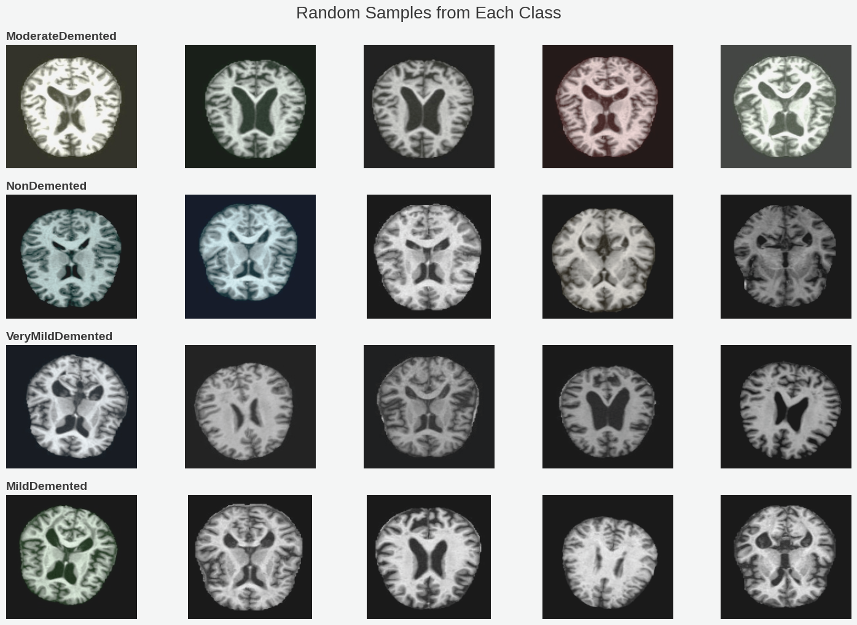
EDA Analysis
4 classes: ModerateDemented, MildDemented, VeryMildDemented, NonDemented
The training set is synthetically balanced; the validation set is realistically imbalanced
Images are clean axial MRI slices (skull-stripped) but have inconsistent resolutions (180×180 to 200×190)
All images will be resized to 128×128 and normalized to [0, 1]
A total of 33,984 images were used for training
For validation, 6,400 images were used

Slide 5
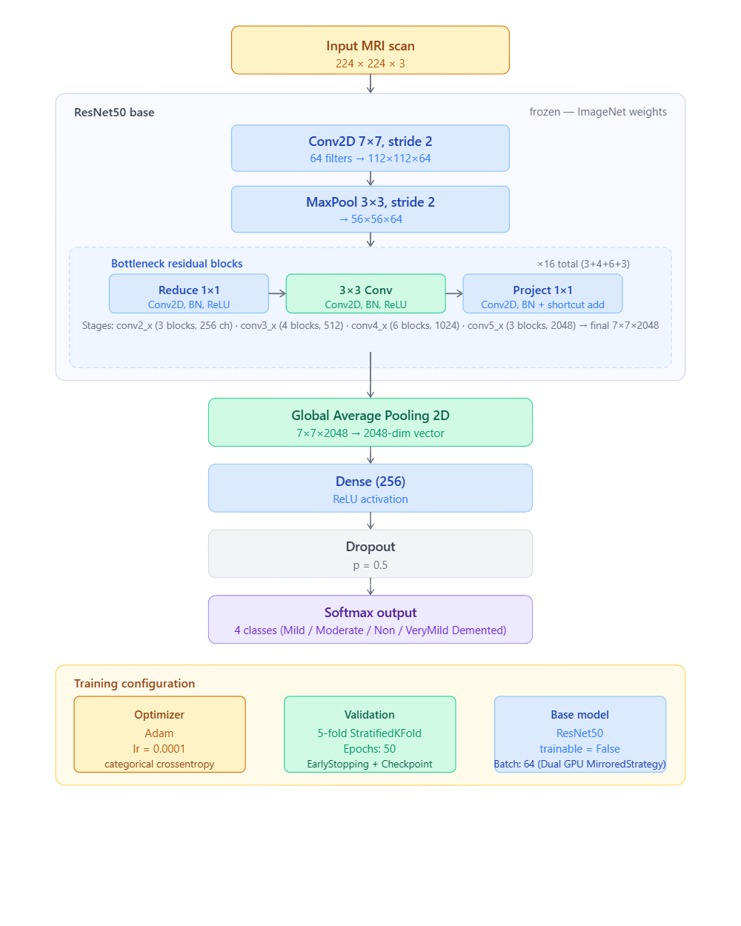
ResNet50 Architecture
Pre-trained on ImageNet
Frozen backbone
Input shape: 224×224×3
Architecture: 50 layers with bottleneck residual blocks
Top layers removed
GlobalAveragePooling2D
Dense(256, ReLU)
Dropout(0.5)
Dense(4, softmax)
Optimizer: Adam (learning rate = 0.0001)
Used in 5-fold StratifiedKFold with MirroredStrategy (Dual GPU)

Slide 6
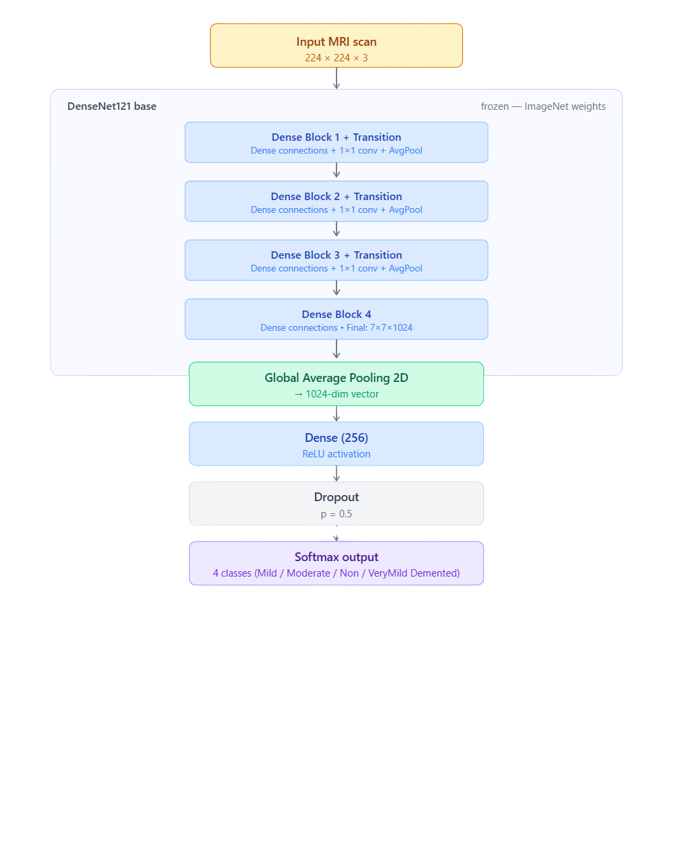
DenseNetV2 Architecture
Pre-trained on ImageNet
Frozen backbone
Input shape: 224×224×3
Architecture: Dense connections (4 Dense Blocks + Transition layers), 121 layers total
Final features: 7×7×1024
GlobalAveragePooling2D
Dense(256, ReLU)
Dropout(0.5)
Dense(4, softmax)
Optimizer: Adam (lr = 0.0001)
Used in 5-fold StratifiedKFold with MirroredStrategy (Dual GPU)

Slide 7
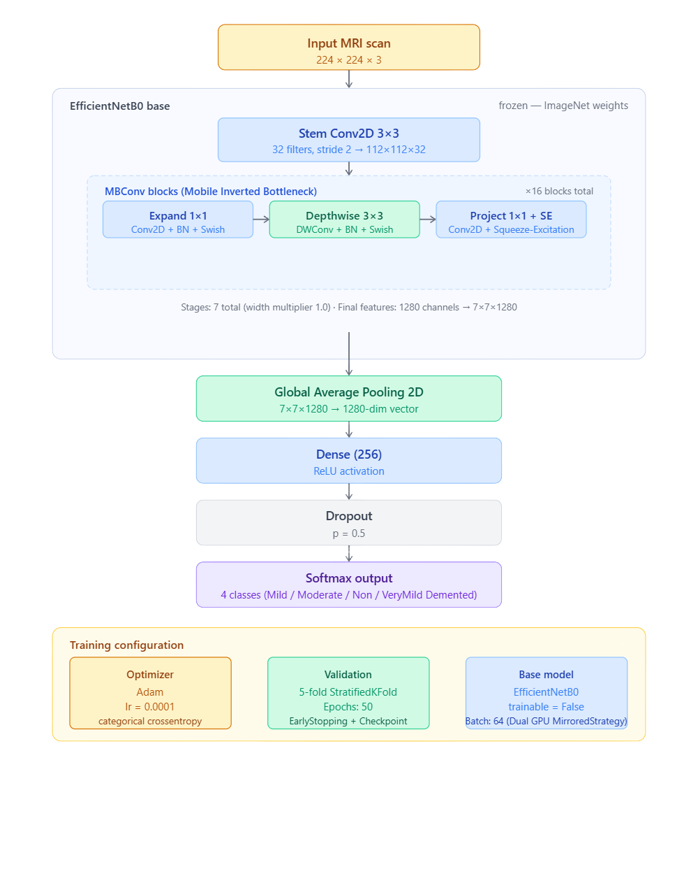
EfficientNetB0 Architecture
Pre-trained on ImageNet
Frozen backbone
Input shape: 224×224×3
Architecture: Compound scaling + MBConv blocks with Squeeze-and-Excitation
Top layers removed
GlobalAveragePooling2D
Dense(256, ReLU)
Dropout(0.5)
Dense(4, softmax)
Optimizer: Adam (learning rate = 0.0001)
Used in 5-fold StratifiedKFold with MirroredStrategy (Dual GPU)

Slide 8
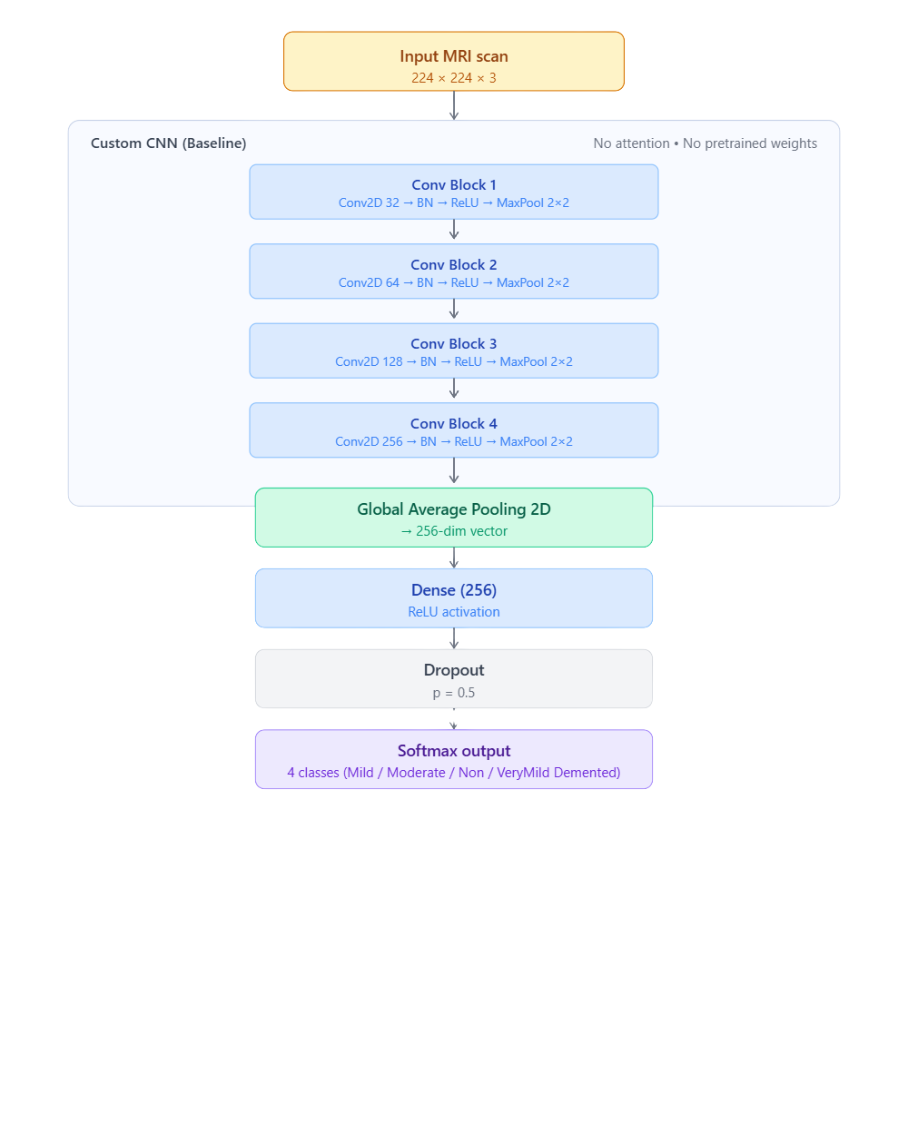
Custom CNN Architecture
Built from scratch (no pretrained weights)
4 Conv Blocks:
Conv2D(32) → BN → ReLU → MaxPool(2×2)
Conv2D(64) → BN → ReLU → MaxPool(2×2)
Conv2D(128) → BN → ReLU → MaxPool(2×2)
Conv2D(256) → BN → ReLU → MaxPool(2×2)
GlobalAveragePooling2D
Dense(256, ReLU)
Dropout(0.5)
Dense(4, softmax)
Optimizer: Adam (learning rate = 0.0001)
Used in 5-fold StratifiedKFold with MirroredStrategy (Dual GPU)

Slide 9
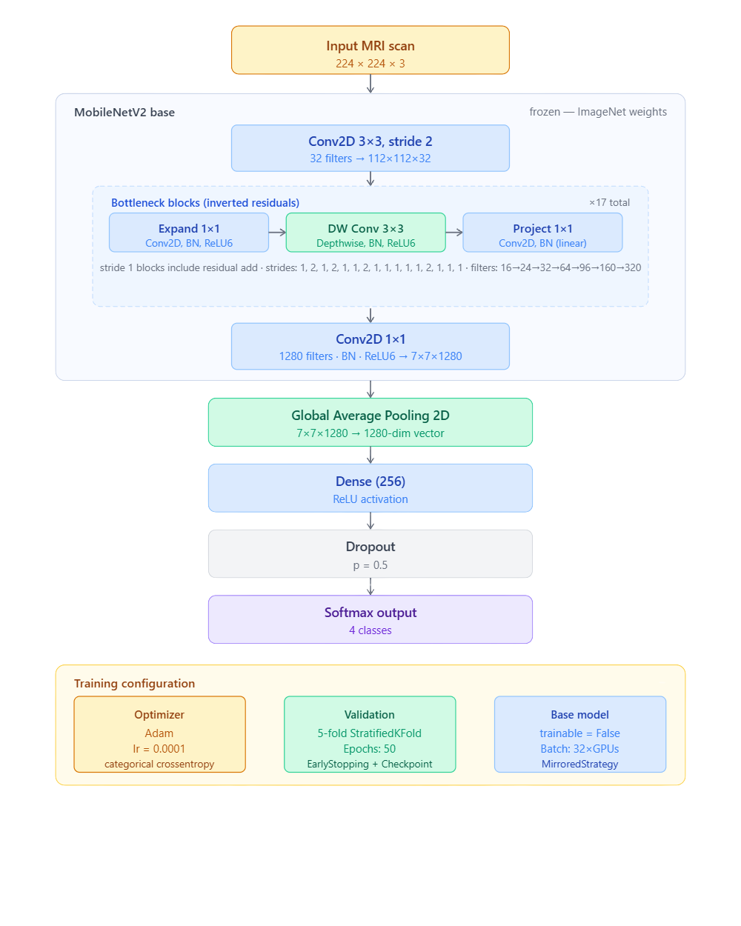
MobileNetV2 Architecture
Pre-trained on ImageNet
Frozen backbone
Input shape: 224×224×3
Architecture: Inverted residual blocks with depthwise separable convolutions
Top layers removed
GlobalAveragePooling2D
Dense(256, ReLU)
Dropout(0.5)
Dense(4, softmax)
Optimizer: Adam (learning rate = 0.0001)
Used in 5-fold StratifiedKFold with MirroredStrategy (Dual GPU)

Slide 10
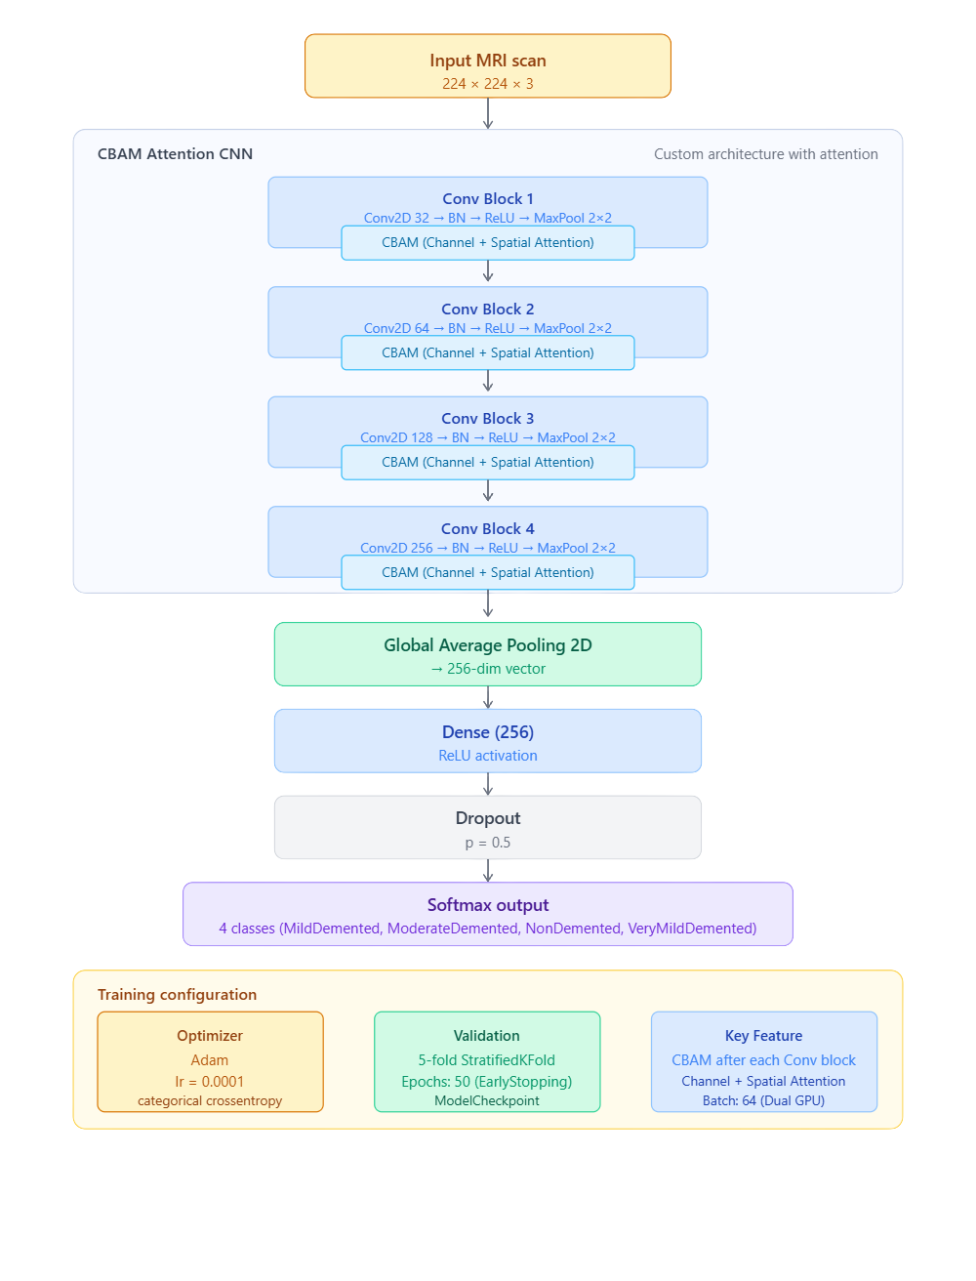
CBAM Architecture
Custom CNN with CBAM (Channel + Spatial Attention)
4 Conv Blocks
Conv2D(32/64/128/256) → BN → ReLU → MaxPool(2×2)
CBAM inserted after every Conv Block
GlobalAveragePooling2D
Dense(256, ReLU)
Dropout(0.5)
Dense(4, softmax)
No pretrained weights
Optimizer: Adam (learning rate = 0.0001)
Used in 5-fold StratifiedKFold with MirroredStrategy (Dual GPU)

Slide 11
Model Comparison
5-fold cross-validation
Research Results
Model | Accuracies | Recall | F1 Score | Precision
CBAM CNN | 93.71% | 93.71% | 93.70% | 93.79%
RESNET50 | 92.87% | 92.87% | 92.87% | 92.92%
MOBILENETV2 | 91.36% | 91.36% | 91.34% | 91.41%
EFFICIENTNETB0 | 88.00% | 88.00% | 87.97% | 87.98%
DENSENET21 | 87.48% | 87.47% | 87.43% | 87.48%
CUSTOM CNN | 72.59% | 72.59% | 71.37% | 76.68%
Why CBAM CNN Surpassed All:
CBAM adds Channel + Spatial Attention after every Conv block
Forces the model to focus on important brain regions (hippocampus, ventricles, atrophy areas)
Suppresses irrelevant background and noise in MRI images
Fully trainable custom architecture (better adaptation than frozen backbones)
Attention mechanism gave huge boost over plain Custom CNN (93.71% vs 72.59%)
Best balance of feature learning + focus for this specific medical task

Slide 12

Artificial Intelligence
Thank You
20 April, 2026

